Slide 1
Physics of Light
Slide Set 8.02

Slide 2
Introduction
This section discusses the physical basis for introducing light sources and how surfaces interact with light.
Later sections will discuss how simplified versions of this model can be used and then we will discuss how to get around the limitations of the simplified models.
Unfortunately, the physical model is too complex to implement directly, at least at this point

Slide 3
Light, Reflection, Transmission
Light is electromagnetic energy in a certain range of wavelengths.
Light is produced by some objects which we will call light sources
Surfaces of objects reflect light
We are not concerned with the physics of reflection in detail, just certain characteristics
The material that a surface is made of determines how light will reflect
Surfaces can also let light through, transmission
We will usually speak of transparency and translucence
The material of a surface and the object volume will determine the transmission characteristics

Slide 4
Basic Model
Light is emitted by one or more light sources, is reflected by surfaces and, eventually, reaches the camera or eye where the light is detected.
Some light will reflect off several surfaces before reaching the eye
Some light will never reach the eye

Slide 5
Light of Interest
We are only interested in light that eventually reaches the eye
The eye is at the center of perspective, so we look at light rays that reach there
The rays pass through the projection plane (usually in front of the center of projection)
Divide up the projection plane into rectangles matching the pixels on the canvas
The rays that pass through each small rectangle determine the color that will be displayed by that pixel.

Slide 6
Ray Tracing
A geometric path starts at the center of projection,
continues through one of the small rectangles in the projection plane
bounces around in the scene, perhaps splitting into multiple paths.
When a path reaches a light source, a contribution is computed for the pixel in the projection plane
This is slower than the direct lighting methods we will use

Slide 7
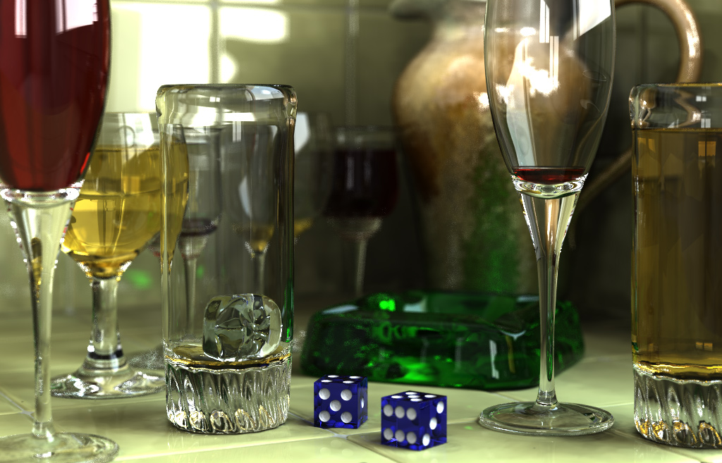
Ray Tracing
The image is an example from the PovRay site
Notice the reflections and refractions

Slide 8
Our Lighting Model
We will not be able to model exactly the physical effects of reflection.
We can approximate the physical effects of lighting by simulating some lighting effects.
Three kinds of lighting
Diffuse
Ambient
Specular

Slide 9
Diffuse Lighting
Used to get shading effects that will provide a feeling of three dimensions
Shading is a basic technique for visual artists
For a perfectly diffuse surface, the amount of light reflected towards a viewer does not depend on which direction the viewer is standing relative to the light source
Lambertian surface

Slide 10
Ambient Lighting
Approximates light reflected among surfaces
We will not try to compute such reflected light directly
Ambient lighting ‘softens’ shadows, some light shines even in the darkest corners
We will approximate ambient lighting as a source of light that is constant throughout a scene

Slide 11
Specular Reflection
Light reflected from a shiny surface
Mostly reflected in the opposite direction from the direction in which the light first hits the surface

Slide 12
Lighting Computation
We will compute the light at a point as a sum of three components: diffuse, ambient, and specular
A general model for light would include a color for each component
A general model of the reflectance of a surface would include measures of how each component would reflect
We will simplify that for our examples

Slide 13
Light Sources
Directional source
Light comes from a certain direction
Distance the light travels does not matter
Point source
Light comes from a particular point
We may or may not model the light becoming less strong the farther away from the source
Area source
Light comes from an area
Often approximated with a set of point sources

